Slide 1
Progress Meeting
3/27/19
Takin’ care of business

Slide 2
Agenda
Cycle 4/5 and Final Objectives
Prototypes 2 and 3
Affiliate’s Day
Showcase
Beyond showcase

Slide 3
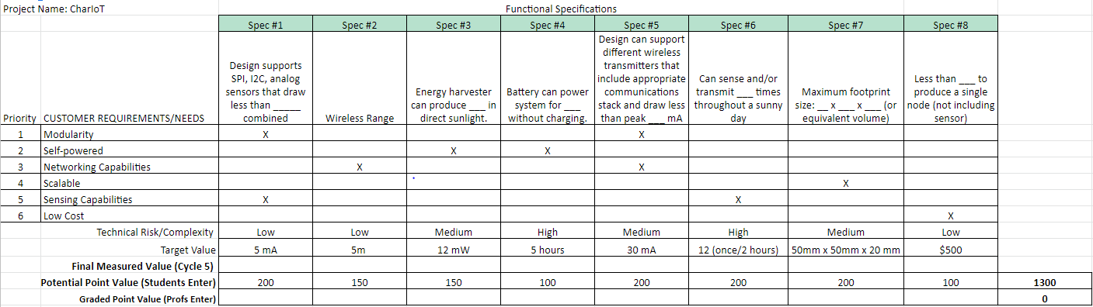
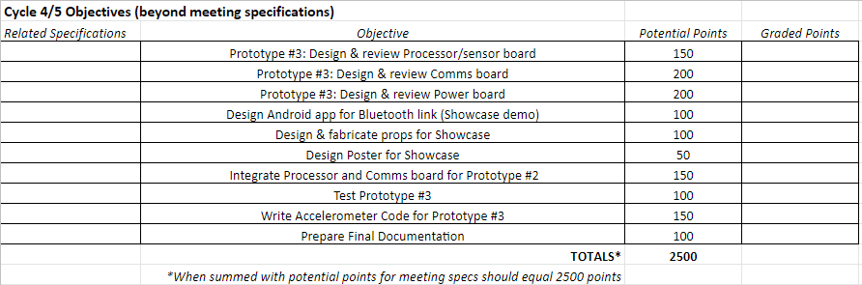
Cycle 4/5 and Final Objectives
Product Development Worksheet

Slide 4
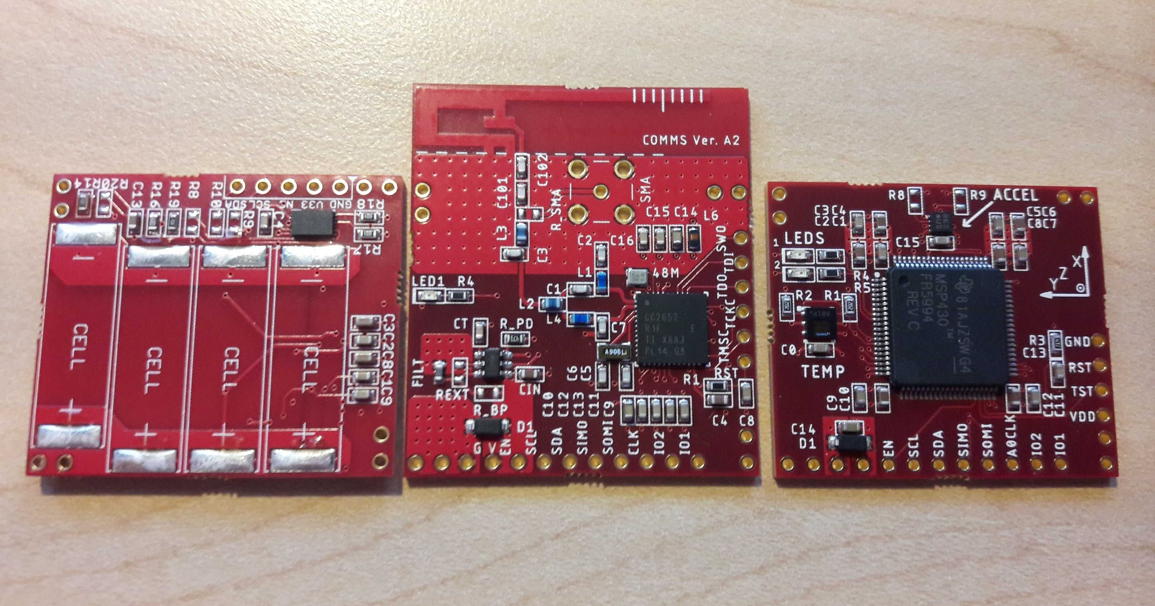
Prototypes 2 and 3
Prototype 3 was picked up yesterday!
It’s beautiful
Working on code for prototype 2
Soldering components onto prototype 3
Assuming the code works on prototype 2, we’ll transition to prototype 3

Slide 5
Affiliate’s Day
Poster
Poster is finished except for:
Updating picture to show Prototype #3 (or at least a flipped power board)
Calculating how often we can TX based on charging current in different conditions
Demo:
Comms board transmitting fixed data to app
Have Prototype #3 out for people to see
We can add more if time allows

Slide 6
Showcase
Demo (Rachel is prepping this stuff):
Acrylic sign of our logo
Small stands to put the active demo nodes on
Poster:
Probably the same as for Affiliate’s Day
Maybe a bit less technical?
Still need
Working data line from MSP to COMMS
Accelerometer code for Prototype #3 (assuming the boards are good)

Slide 7
Beyond Showcase
External Competition Submission
Open for submission March-June
TI Writeup
Because they gave us free stuff
Final Presentation
Only to you?
Documentation?
Sponsor Meeting?
Other?

